Slide 1
Big Mountain Ski Resort Data-Driven Insights and Optimization Strategies:
Utilizing Industry Data to Project Optimal Ticket Pricing and Explore Revenue-Enhancing Strategies

Slide 2
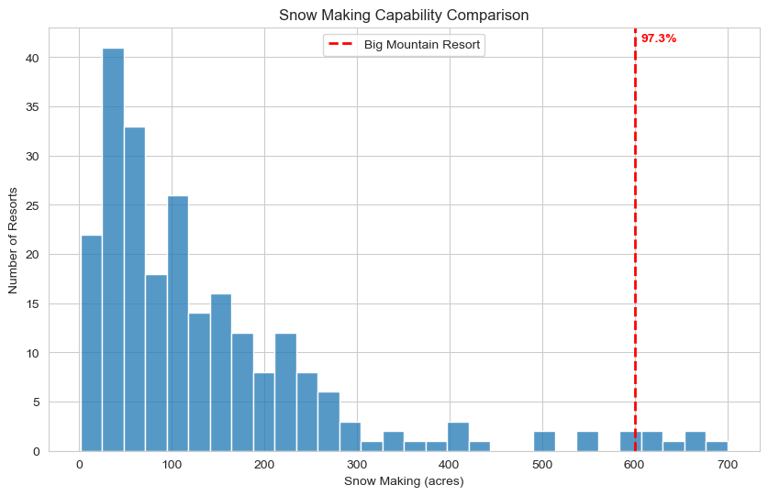
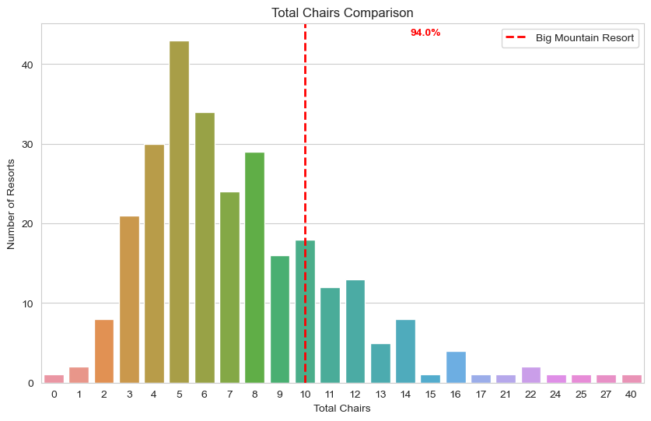
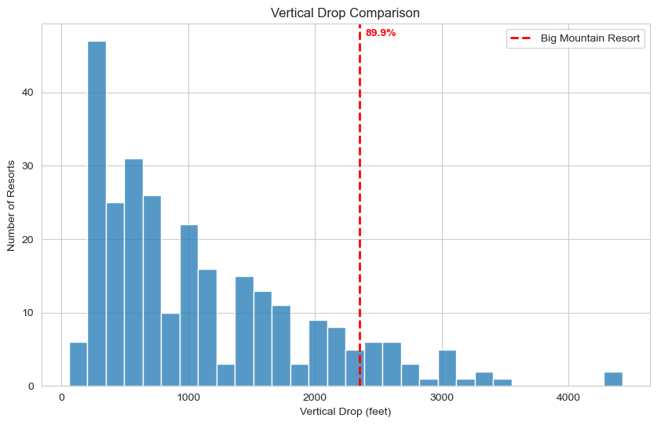
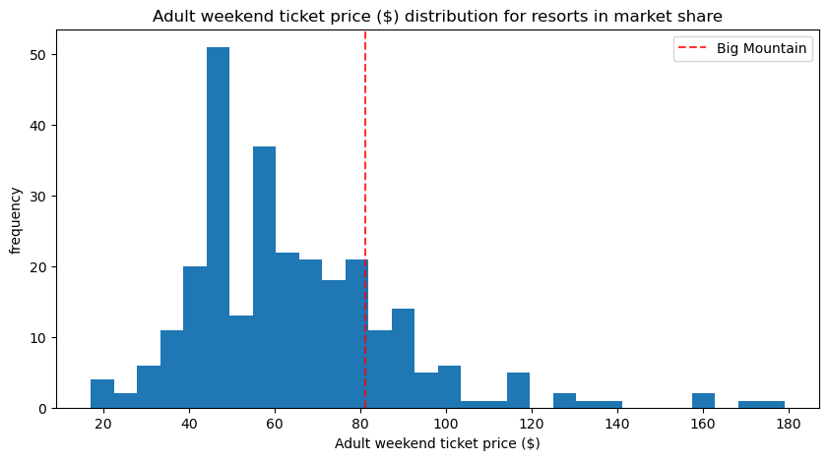
Big Mountain Resort's Pricing Challenge
Current market position may not fully leverage resort facilities
Opportunity to increase revenue for the 2024 snow season through optimized ticket pricing

Slide 3
Strategic Recommendations for 2024 Season
Recommendation:
Implement developments as outlined in Scenario 2
Adjust ticket price to $95.87 reflecting market-supported value
Key Findings:
Scenario 2 enhancements justify a price increase of $1.99
Anticipated revenue boost of ~$3.47M over the season

Slide 4
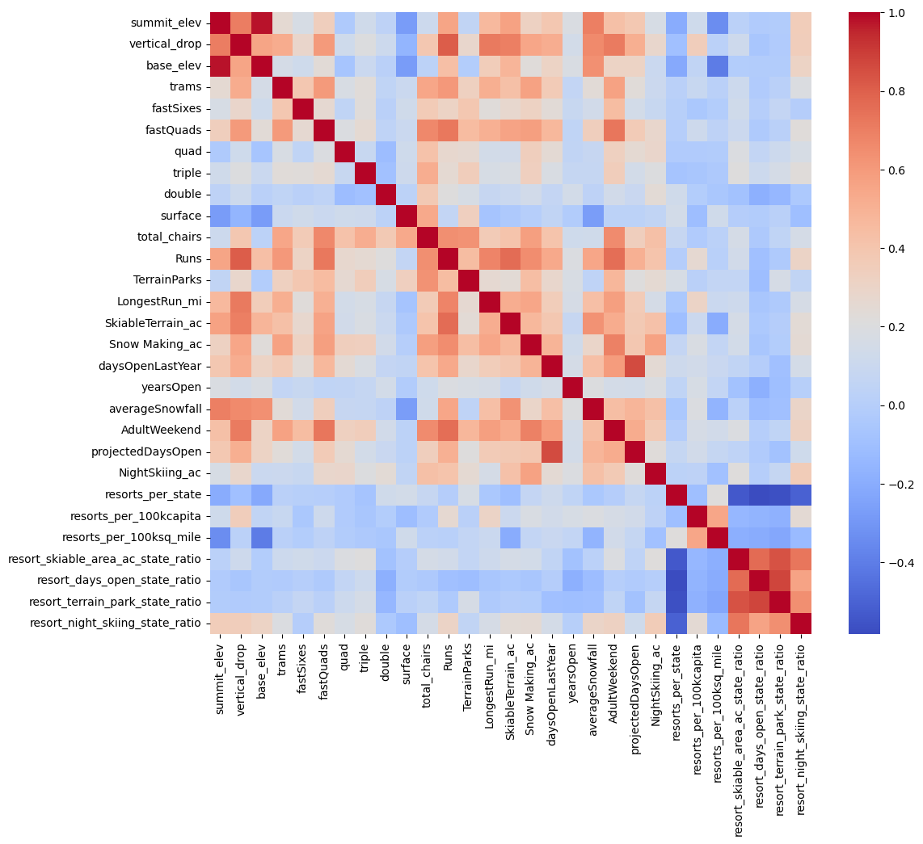
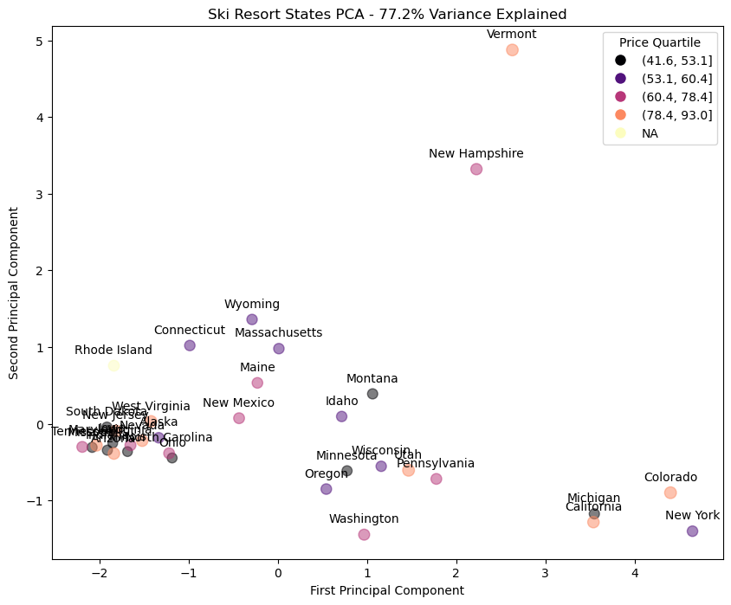
Insights from EDA on 277 Ski Resorts
Geographic location does not significantly influence ticket price
Resort features and amenities strongly correlated with ticket pricing
Notable correlates of ticket price:
Total number of ski runs
Snowmaking area covered
Longest run
Total number of chair lifts

Slide 5
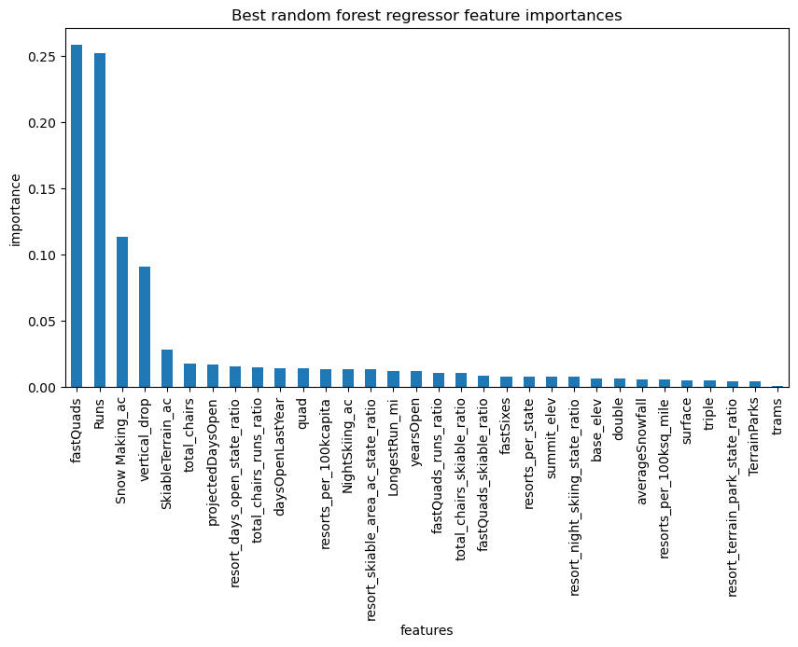
Model Selection and Findings
Model Chosen: Random Forest Regressor
Feature Importance Analysis:
Number of fast quad lifts
Number of ski runs
Snowmaking area covered
Vertical drop

Slide 6
Revenue Impact: Scenario Analysis
Scenario 1 - Closing Runs:
Closing one run does not affect the support for ticket price.
Closing 2-3 runs slightly reduces ticket price support.
Closing six or more runs leads to a significant drop in ticket price support.
Minimal cost but minimal impact
Scenario 2: Adding Facilities
Add a run, increase the vertical drop by 150 ft., and install an additional chair lift
Justifies ticket price increase by $1.99, leading to an additional $3,474,638 in revenue over the season
Scenario 3: Adding Facilities + Increase Snow Making
Add two acres of snow making + changes in Scenario 2
Does not further increase ticket price support or revenue
Requires detailed cost-benefit analysis
Scenario 4: Extending Longest Run + Increase Snow Making
Increase the longest run by 0.2 miles and add 4 acres of snow
Does not further increase ticket price support or revenue

Slide 7
Conclusion and Next Steps
Strategic Price Increase
Scenario Implementation
Next Steps
Adjust ticket price to $95.87 reflecting market-supported value
Add a run, increase the vertical drop by 150 feet, and install an additional chair lift
Boosts revenue by $3,474,638 over the season
Detailed cost-benefit analysis
More scenario testing

